Slide 1





dabl
Automatic ML with a human in the loop
Andreas Müller
Associate Research Scientist
Columbia University
Scikit-learn Technical Committee
Notes:
Hi, I’m Andreas Mueller. I’m grateful for the opportunity to talk to you today about my work here at the DSI, and about Open Source for Science and Data Science.
I’m an Associate Research Scientist, and I mostly work on open source software for machine learning, in particular the scikit-learn library.
My talk will have two parts: first, I want to talk a bit about the importance of software for science, and the scientific python ecosystem.
Then I’ll talk more about the particular project I’m working on, scikit-learn, and my group here at Columbia.

Slide 2
A real world ML workflow
Data Cleaning
Visualization
Model Building
Data Collection
Model Interpretation
Business evaluation

Slide 3
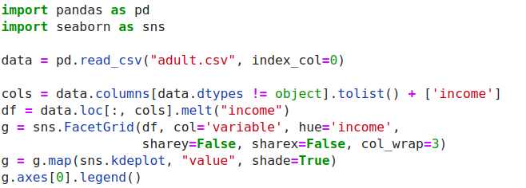
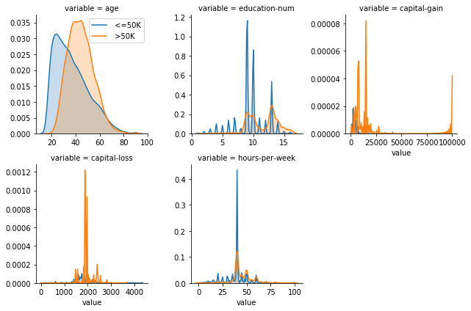
ML with sklearn & pandas

Slide 4
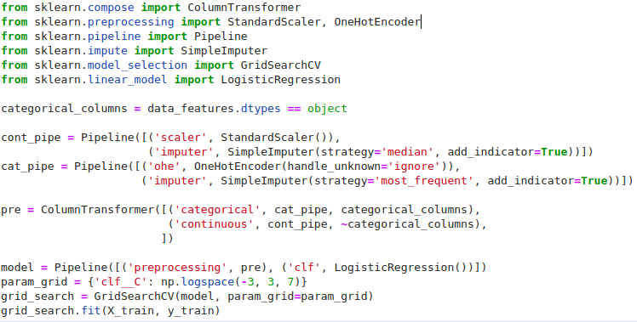
ML with sklearn & pandas

Slide 5
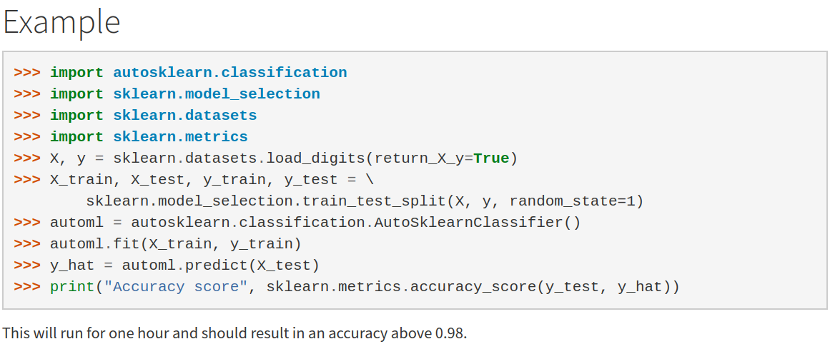
Current Automatic ML frameworks

Slide 6


Slide 7
Workflow again

Slide 8
Data cleaning
& preprocessing

Slide 9
Detect types
Clean strings (a bit)
Missing / rare values
Detect ordinal vs categorical
Assemble sklearn pipeline

Slide 10
Visualization

Slide 11
Univariate plots

Slide 12
Mosaic Plots

Slide 13
Pairwise Plots

Slide 14
Principal Component Analysis

Slide 15
Linear Discriminant Analysis

Slide 16
A note on scatter plots?

Slide 17
Simple Prototypes

Slide 18
Get Results Fast
NB
Stumps
Linear

Slide 19
Automatic Model Search

Slide 20
Complex Models
Random forest
Gradient boosting
Kernel methods

Slide 21
Side note: HistGradientBoosting

Slide 22
Successive Halving

Slide 23
Portfolio creation

Slide 24
Submodular optimization?

Slide 25
Model Explanation

Slide 26
Metrics
Roc, PR, ….

Slide 27
Coefficients / Feature importances

Slide 28
Permutation Importance

Slide 29
Partial Dependence Plots

Slide 30
Examples

Slide 32
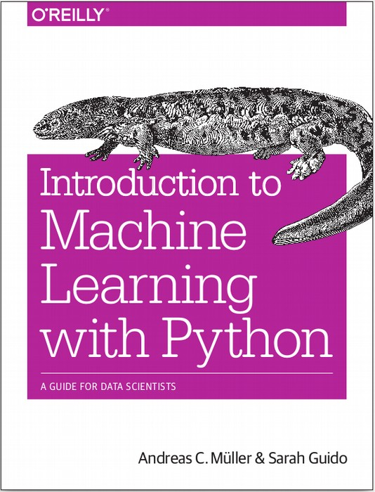




amueller.github.io
@amuellerml
@amueller
andreas.mueller
@columbia.com
Notes:
Thank you for your attention and I’m happy to take any questions!

